Slide 1

STAN4SWAP Stakeholders’ Final restitution Workshop “Swappable Battery Systems: A Clean Revolution for European Urban Mobility?”
06 October 2025
AGENDA
This project has received funding from the European Union’s Horizon Europe research and innovation programme under grant agreement No. 101135417. Additionally, This Work has received funding from the Swiss State Secretariat for Education, Research and Innovation (SERI) for its Associate Partner.

Slide 2
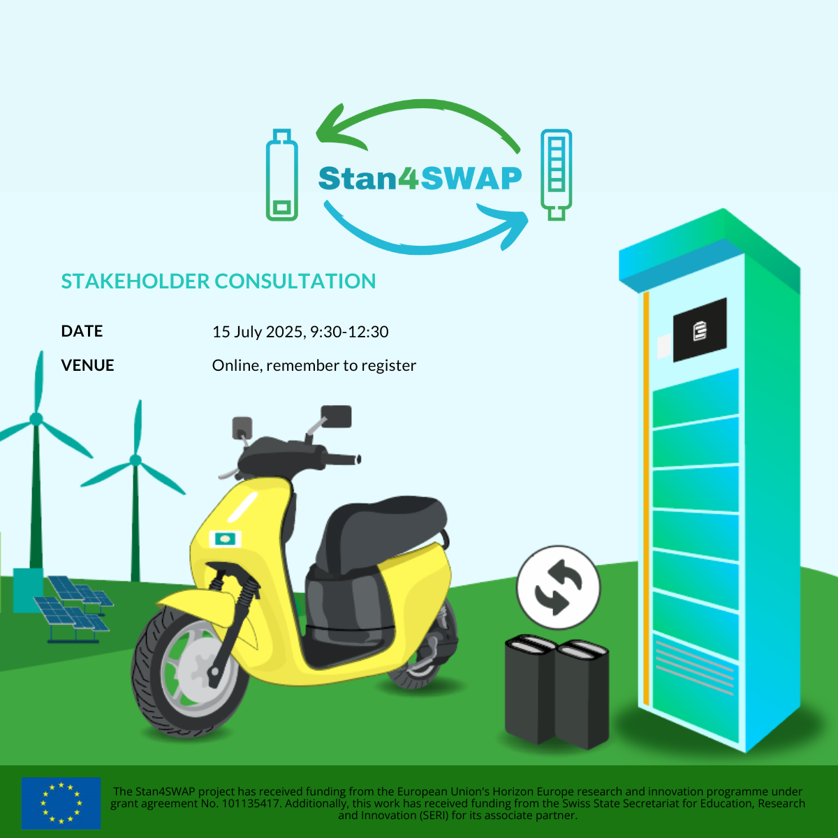
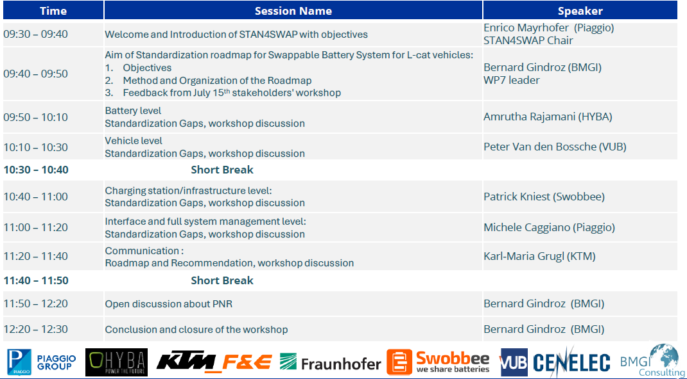
Communication
06 October 2025, 9:30-12:30
Online, remember to register
This project has received funding from the European Union’s Horizon Europe research and innovation programme under grant agreement No. 101135417. Additionally, This Work has received funding from the Swiss State Secretariat for Education, Research and Innovation (SERI) for its Associate Partner.

Slide 3
Communication
The Eco-System
Identification of:
entities which needs to communicate with each other
information/data which needs to be communicated
technology (means) of communication

Slide 4
Communication
strategic considerations on data types
Essential Data
Data which is necessary for the operation of the ecosystem
Optional Necessary Data
Data which necessary for the implementation of the eco-system as such or for individual items within the eco-system, such as data required by regulation (i.e. EU Battery Regulation)
Optional Additional Data
Data which is neither essential nor necessary, but which can support the operation of the eco-system
Take into account:
Data Protection and Data Privacy (i.e. EU GDPR)
Cyber Security (i.e. EU CRA)
Data Ownership / Data Sharing (i.e. EU Data-Act)
This project has received funding from the European Union’s Horizon Europe research and innovation programme under grant agreement No. 101135417. Additionally, This Work has received funding from the Swiss State Secretariat for Education, Research and Innovation (SERI) for its Associate Partner.

Slide 5
Communication
Technologies
Means of communication
Direct communication
(CAN)
Visual communication (label/marking)
Written communication (accompanying documents)
Digital wireless communication
long range (Internet, Wireless Network)
short range (DSRC/WiFi)

Slide 6
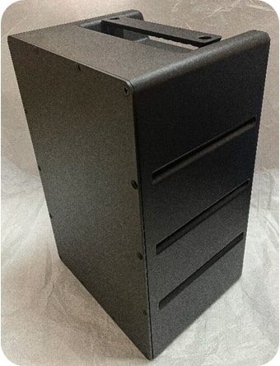
Battery Communication
in more detail on the example of the standardized battery
Means of communication
Communication protocol
(CAN)
e.g. State of charge (SOC)
Visual communication (label/marking)
e.g. Separate collection symbol
Swappable
Battery
Written communication (accompanying documents)
e.g. Instructions and safety information
Digital communication
(QR-code)
e.g. Digital battery passport
This project has received funding from the European Union’s Horizon Europe research and innovation programme under grant agreement No. 101135417. Additionally, This Work has received funding from the Swiss State Secretariat for Education, Research and Innovation (SERI) for its Associate Partner.

Slide 7
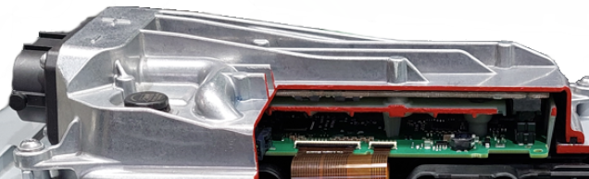
Battery Communication Protocol
in more detail on the example of the standardized battery
Standardized Communication protocol (BMS via communication interface, i.e. CAN)
Counter frame incl. Cyclic Redundancy Check
States:
SOC
BMS
SOH
remaining capacity
evolution of self-discharge rates
Information
battery identification
max. charge voltage
min. pack voltage
discharge/charge limit
software reset
Expected lifetime
date of manufacture
energy & capacity throughput
tracking of harmful events
no. charge-discharging cycles
Basic measured
sensor information
Current
Voltage
Temperature (min., max., avg.)
Errors
This project has received funding from the European Union’s Horizon Europe research and innovation programme under grant agreement No. 101135417. Additionally, This Work has received funding from the Swiss State Secretariat for Education, Research and Innovation (SERI) for its Associate Partner.

Slide 8
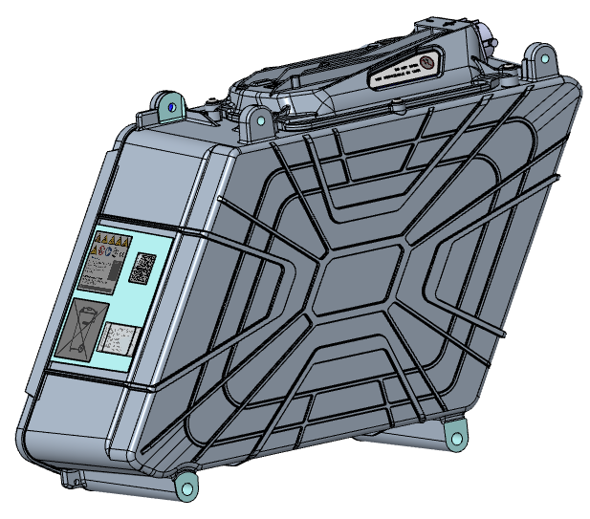



Battery Visual Communication
in more detail on the example of the standardized battery
Consider the framework for a standardized label on battery level
Label material requirements → Robustness over lifetime of the battery
Special focus on standardized & essential safety warnings via pictograms
Label
manufacturer info
battery identification info
battery category
place & date of manufacture
weight
capacity
chemistry
hazardous substances
usable extinguishing agent
critical raw materials
carbon footprint
safety warnings
Marking
Cd Pb
This project has received funding from the European Union’s Horizon Europe research and innovation programme under grant agreement No. 101135417. Additionally, This Work has received funding from the Swiss State Secretariat for Education, Research and Innovation (SERI) for its Associate Partner.

Slide 9
Battery Written Communication
in more detail on the example of the standardized battery
Consider a broad framework for standardized docs:
Safety Information
Operating Instructions
Technical Documentation
EU DoC
…
Owners Manual
Battery Type xxx
Manufacturer yyy
…
This project has received funding from the European Union’s Horizon Europe research and innovation programme under grant agreement No. 101135417. Additionally, This Work has received funding from the Swiss State Secretariat for Education, Research and Innovation (SERI) for its Associate Partner.

Slide 10







Battery Digital Communication
in more detail on the example of the standardized battery
Battery passport standardization
Standardization of detailed aspects within the digital battery passport
Alignment with the standardization activities of the Digital Product Passport
Digital Battery Passport
Battery identification
manufacturer
battery category
model
Usage data
charging cycles
temperature behavior
Manufacturing data
place
date
material composition & origin
https://www.europarl.europa.eu/committees/de/digital-product-passports-enhancing-tran/product-details/20220510CHE10181
End-of-life
recycling instructions
take-back system
Technical specifications
capacity
voltage
weight
Sustainability
carbon footprint
recycling content
This project has received funding from the European Union’s Horizon Europe research and innovation programme under grant agreement No. 101135417. Additionally, This Work has received funding from the Swiss State Secretariat for Education, Research and Innovation (SERI) for its Associate Partner.

Slide 11

Communication
Summary – Recommendations for Standardization Roadmap
The entire Eco-System needs to be considered
Carefully consider the Content of Data Types
Essential Data
Optional Necessary Data
Optional Additional Data
Standards need to support robust solutions for Cybersecurity, Data- Privacy and Data-Ownership
Essential Data
OND
OAD
This project has received funding from the European Union’s Horizon Europe research and innovation programme under grant agreement No. 101135417. Additionally, This Work has received funding from the Swiss State Secretariat for Education, Research and Innovation (SERI) for its Associate Partner.

Slide 12
Introduction to discussion and expected inputs
This project has received funding from the European Union’s Horizon Europe research and innovation programme under grant agreement No. 101135417. Additionally, This Work has received funding from the Swiss State Secretariat for Education, Research and Innovation (SERI) for its Associate Partner.
Notes:
Thank you for your attention!

