Slide 1
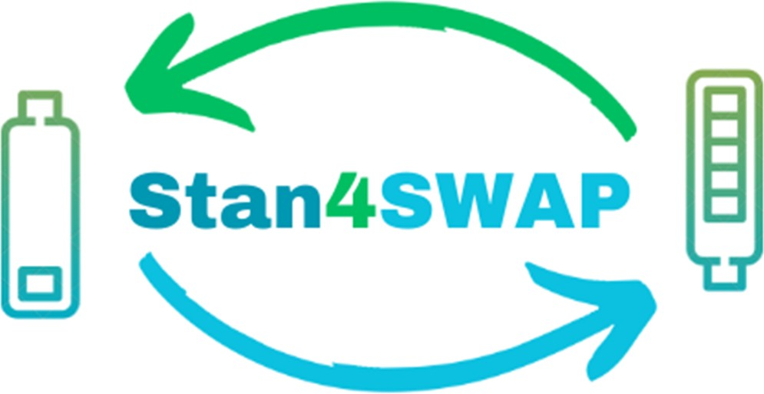
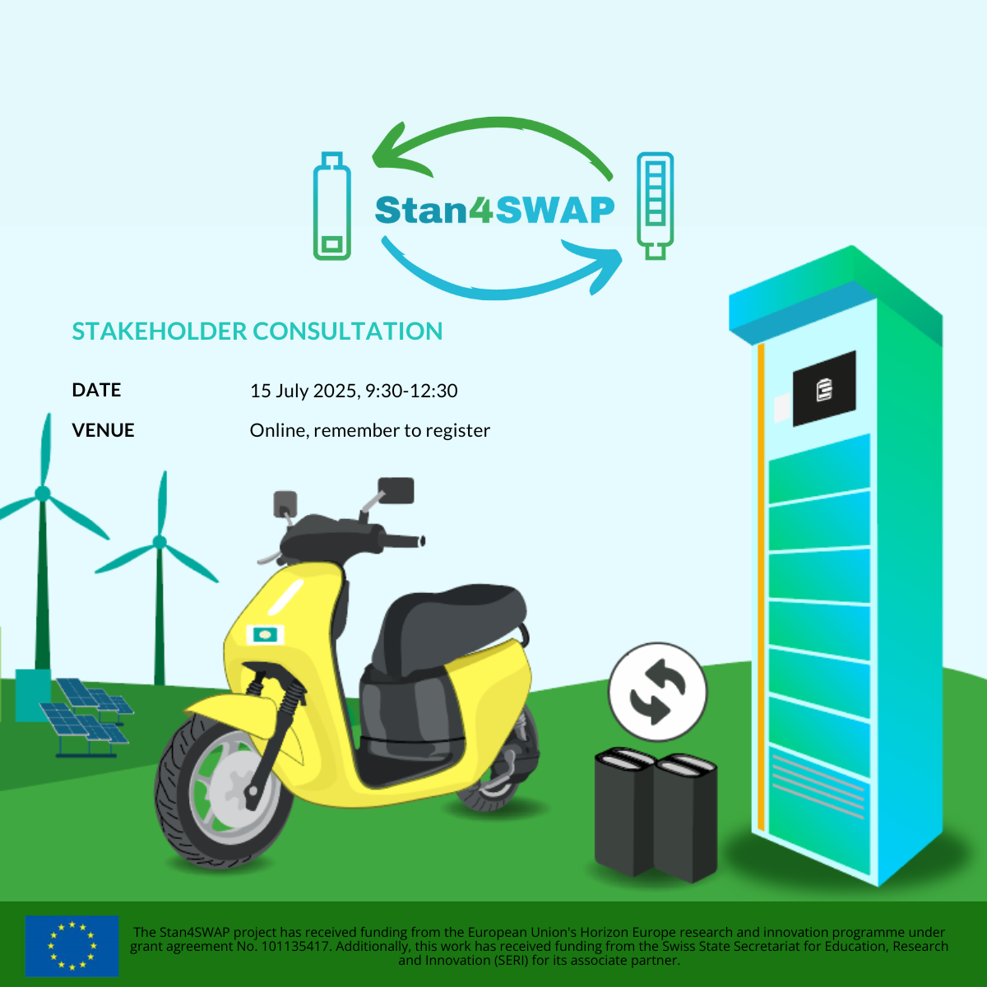

Introduction to Charging Station / Infrastructure Level
Patrick Kniest
CTO of Swobbee
This project has received funding from the European Union’s Horizon Europe research and innovation programme under grant agreement No. 101135417. Additionally, This Work has received funding from the Swiss State Secretariat for Education, Research and Innovation (SERI) for its Associate Partner.

Slide 2
Introduction to Charging Station / Infrastructure Level
Classification of topics
(Pre)Installation relevant regulations
To install station you will need permissions from different stake holder
  Public government (mostly already regulated)
  Main holding / parent company
  Landlords and local site managers
Regulations and standards for operations
  Value of assets
  Tracking of energy, usage or degradation
  Finanzial and insurance topics
This project has received funding from the European Union’s Horizon Europe research and innovation programme under grant agreement No. 101135417. Additionally, This Work has received funding from the Swiss State Secretariat for Education, Research and Innovation (SERI) for its Associate Partner.

Slide 3
Charging Station / Infrastructure Level - (Pre)Installation relevant regulations
Standard installation criteria for swapping stations (indoor/outdoor, safety zones, mechanical footprints).
  Harmonized building/permitting codes across regions.
  Standard footprints/connectors for kiosk installations.
  Ventilation & spacing guidelines.
Fire safety for battery systems (swap cabinets, charging areas, storage).
  Harmonized fire protection req’ts (indoor/outdoor).
  Streamlined testing/certification for Li-ion thermal runaway & propagation mitigation.
  Unified safety assessment for large battery deployments.
This project has received funding from the European Union’s Horizon Europe research and innovation programme under grant agreement No. 101135417. Additionally, This Work has received funding from the Swiss State Secretariat for Education, Research and Innovation (SERI) for its Associate Partner.

Slide 4
Charging Station / Infrastructure Level - Regulations and standards for operations
Accurate calculation of battery capacity, SoC, usage patterns for daily ops.
  Unified SoC/SoH data model across different OEMs/stations
  Standard method for energy throughput & battery life predictions.
  Common data exchange format.
Ensuring (or clarifying) tax exemptions/levies for battery swapping, electricity usage, battery
  Clarify tax treatment (energy supply vs. service?).
Uniform insurance coverage requirements for battery systems (fire, damage, liability) and swap-station operations.
  Risk models for battery handling/storage.
  Clear underwriting guidelines for multi-operator systems.
This project has received funding from the European Union’s Horizon Europe research and innovation programme under grant agreement No. 101135417. Additionally, This Work has received funding from the Swiss State Secretariat for Education, Research and Innovation (SERI) for its Associate Partner.

