Slide 1


STAN4SWAP Stakeholders’ Workshop “Swappable Battery Systems: A Clean Revolution for European Urban Mobility?”
06 October 2025
AGENDA
This project has received funding from the European Union’s Horizon Europe research and innovation programme under grant agreement No. 101135417. Additionally, This Work has received funding from the Swiss State Secretariat for Education, Research and Innovation (SERI) for its Associate Partner.

Slide 2
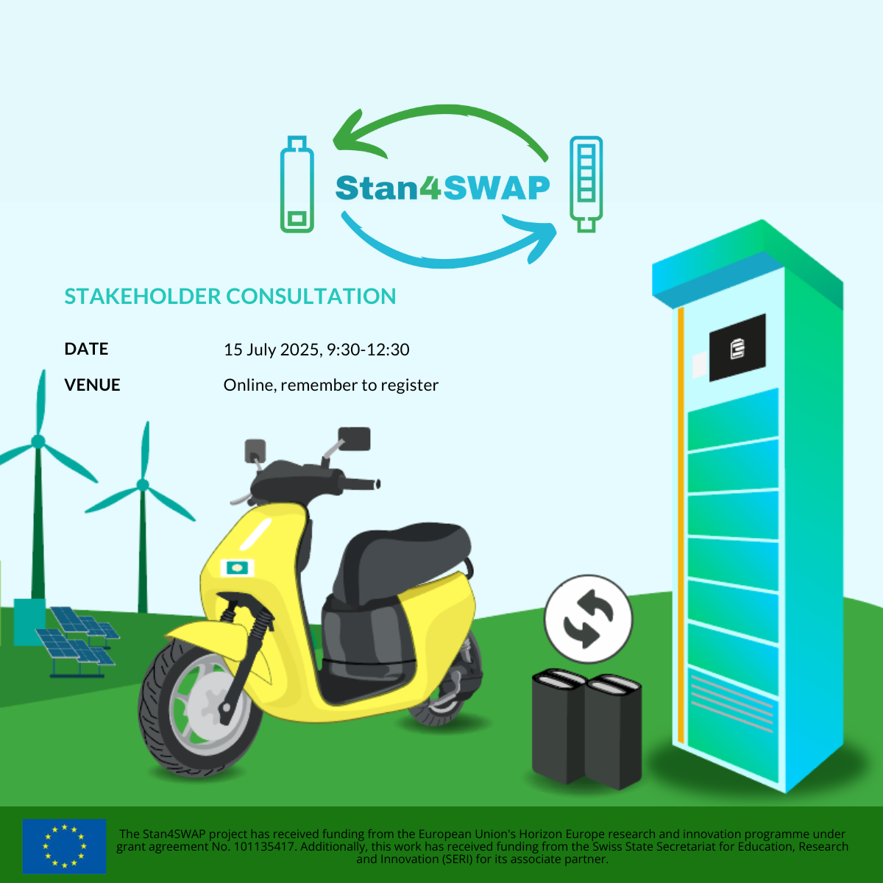
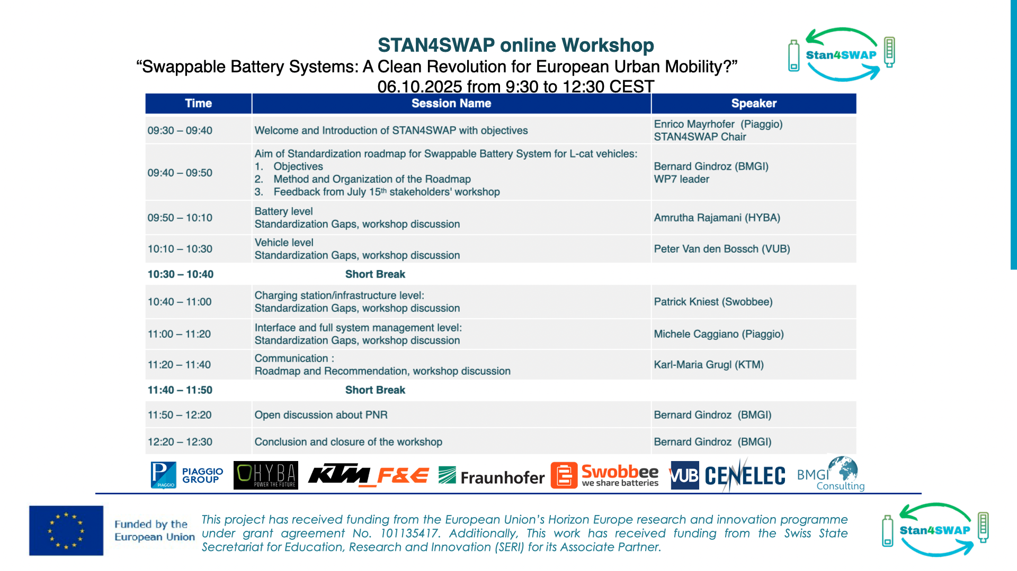
Agenda
06 October 2025, 9:30-12:30
Online, remember to register
This project has received funding from the European Union’s Horizon Europe research and innovation programme under grant agreement No. 101135417. Additionally, This Work has received funding from the Swiss State Secretariat for Education, Research and Innovation (SERI) for its Associate Partner.

Slide 3
Standardization Gaps at Vehicle level
This project has received funding from the European Union’s Horizon Europe research and innovation programme under grant agreement No. 101135417. Additionally, This Work has received funding from the Swiss State Secretariat for Education, Research and Innovation (SERI) for its Associate Partner.

Slide 4
Vehicle standardization gaps: The Swappable battery
The ideal: universal swappable battery (for a vehicle class)
One battery type for several vehicle types
Mechanical
definition of physical dimensions
Electrical
definition of electrical requirements
Interface
definition of connector requirements
definition of vehicle <> battery communications
Interested committees
CEN TC301
ISO TC22 SC38
Regulatory aspects: BattR, AFIR
This project has received funding from the European Union’s Horizon Europe research and innovation programme under grant agreement No. 101135417. Additionally, This Work has received funding from the Swiss State Secretariat for Education, Research and Innovation (SERI) for its Associate Partner.

Slide 5
Vehicle standardization gaps: The Vehicle Type Approval
Whole vehicle type approval “WVTA”
Including the battery?
Vehicle performances (for safety classification)
defined by drive
not by battery
Approval without fixed battery
Regulatory issue (168/2013)
This project has received funding from the European Union’s Horizon Europe research and innovation programme under grant agreement No. 101135417. Additionally, This Work has received funding from the Swiss State Secretariat for Education, Research and Innovation (SERI) for its Associate Partner.

Slide 6
Vehicle standardization gaps: The Vehicle On Board Charger
Battery charging on-board
61851-3 series
AC connection
62196-2 (Mode 3) or Mode 1 with standard plug
DC connection
No harmonized connectors in AFIR
Out of scope S4S
This project has received funding from the European Union’s Horizon Europe research and innovation programme under grant agreement No. 101135417. Additionally, This Work has received funding from the Swiss State Secretariat for Education, Research and Innovation (SERI) for its Associate Partner.

Slide 7
Introduction to polls sessions and expected inputs
Link and connection details….
This project has received funding from the European Union’s Horizon Europe research and innovation programme under grant agreement No. 101135417. Additionally, This Work has received funding from the Swiss State Secretariat for Education, Research and Innovation (SERI) for its Associate Partner.

